Slide 1


Speakers
Tony Zhao
Isaura Cabrera
Current Business Analytics Student’22
Undergrad Majors: Accounting & Business Administration
International student from China
Currently major in Business Analytics

Slide 2

JARVIS

Slide 3

Table of Contents
Introduction
Who is Jarvis?
Recap
Goals
Challenges Decoding & Missing Data
GMAIL API Challenges
Demo
Conclusion
Q&A

Slide 4

Who is Jarvis?
JARVIS stands for JUST A RATHER VERY INTELLIGENT SYSTEM.
JARVIS is originally known from the movie Iron Man. Jarvis is an AI that was created by the main character Tony Stark. We decided to implement that name to our project.

Slide 5

Introduction
Jarvis is an email rule that can assist its users in classifying various emails as Spam. Which is similar to the Spam/ Ham rule. The email is being classified(labeled) by Jarvis based on the key words of the Subject line, as well as the body of the email. Jarvis will be assisting both the Innovation Center & Students.

Slide 6
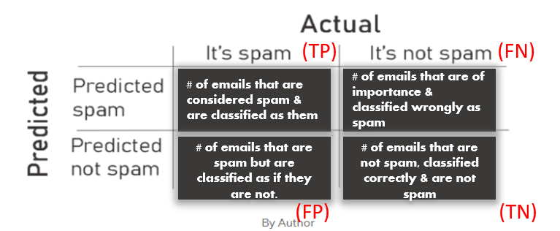
Recap
Below are various steps taken during the production of JARVIS:
Creating a Test Email
Modifying Security Settings
Importing appropriate coding libraries
Extracting several emails as data
Creating an email sample, from emails that were displayed
Decoding, cleaning data from HTML to readable files
Analyzing our data
Implementing the Email Rule

Slide 7
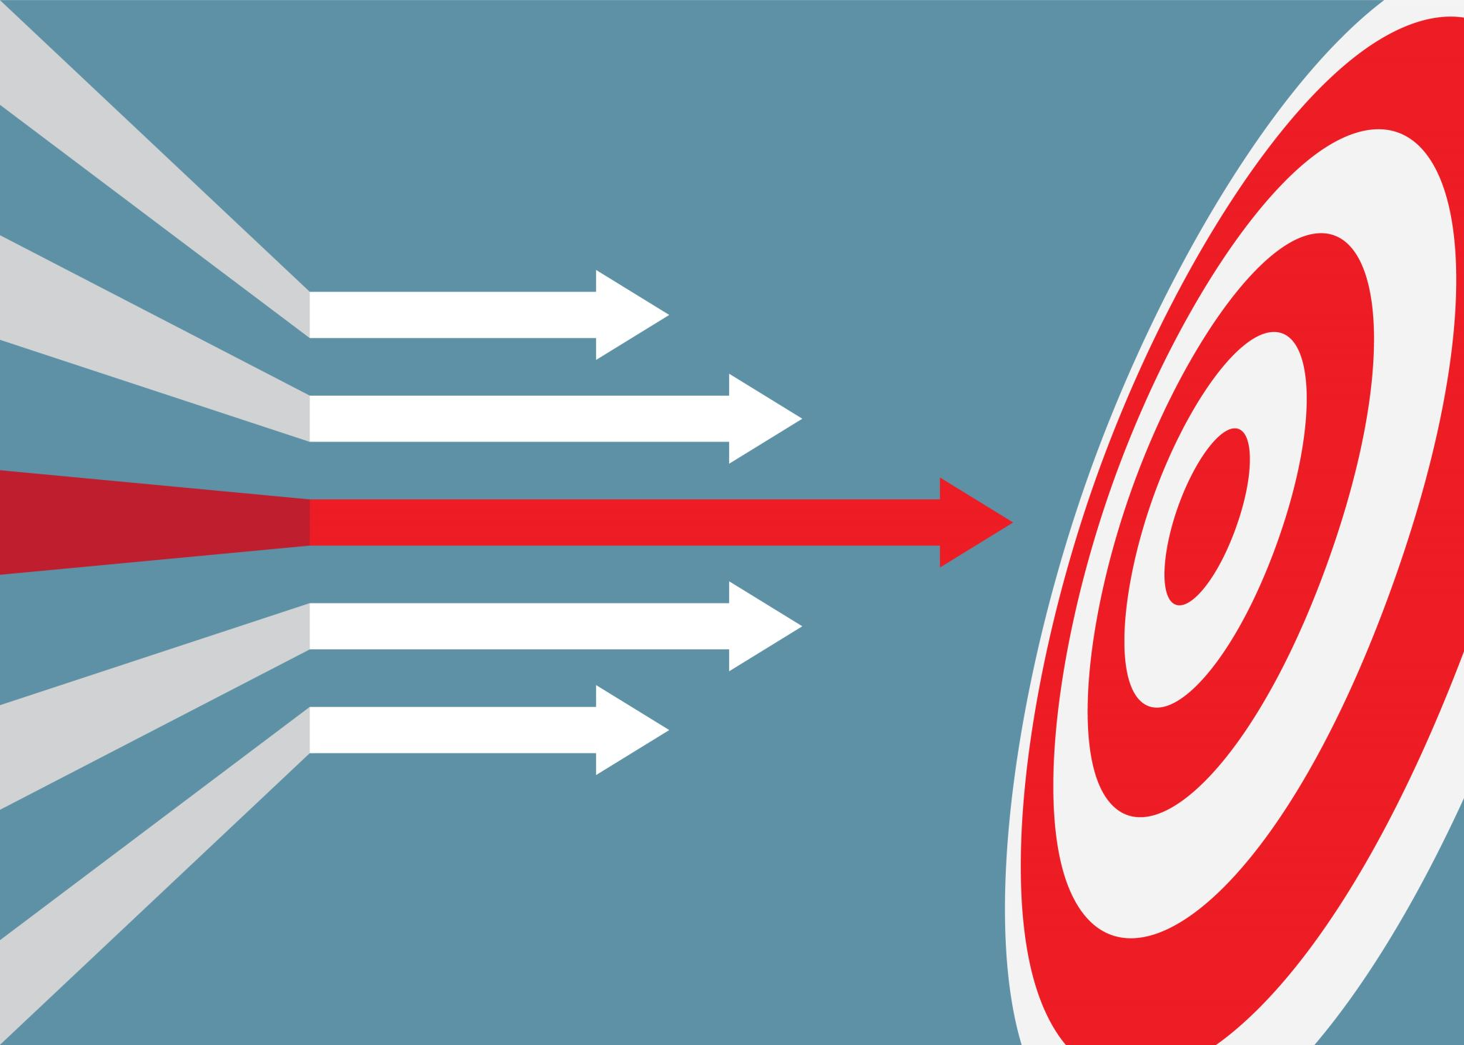
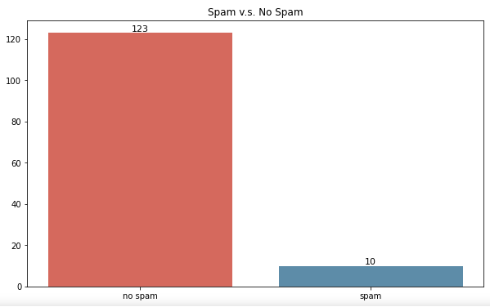
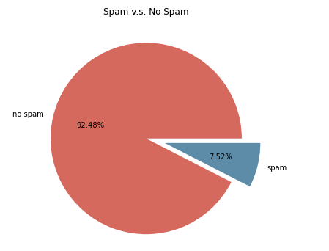
Goals
Our Goals for Jarvis is to successfully learn what emails will be labeled as Spam or have important information. Jarvis will also grant the user the freedom of viewing their emails, effortlessly by a quick command.

Slide 8

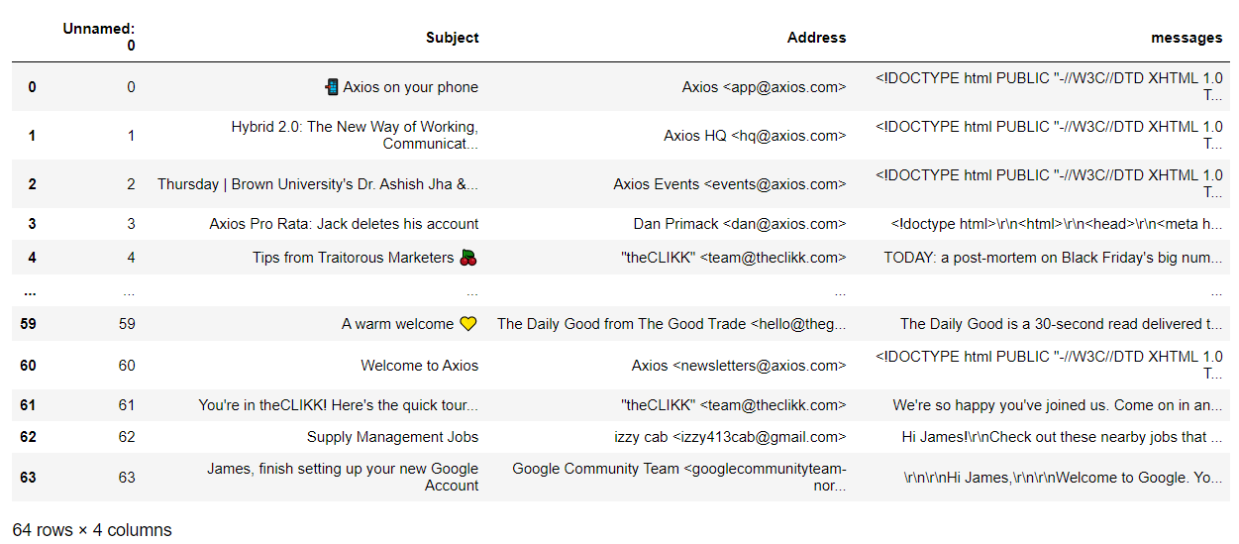
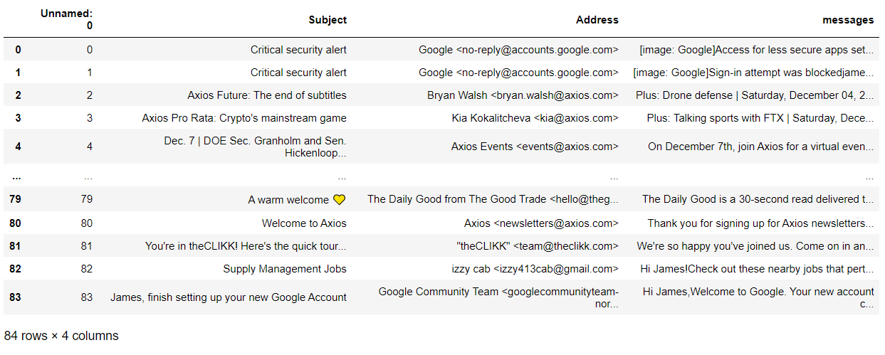
Challenges Decoding & Missing Data
Scraping emails from demo emails, then extracting data with IMAP to create the demo dataset.
Processing data and decoding HTML formatted emails, which are the byte messages, with Beautiful Soup to make them readable in our own dataset.

Slide 9
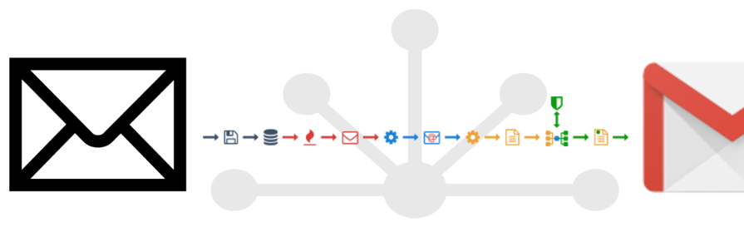
GMAIL API Challenges
After requesting permission, retrieving tokens and your own client secret code. You can add users to join your project and grant them full access to the project. Unfortunately, I was the only user that was granted permission. GMAIL API allows it users to modify, create, read & delete messages. There are countless of forums but are outdated information to assist. Our main challenge overall was running our code and the tokens displaying errors, when trying to filter spam.

Slide 10
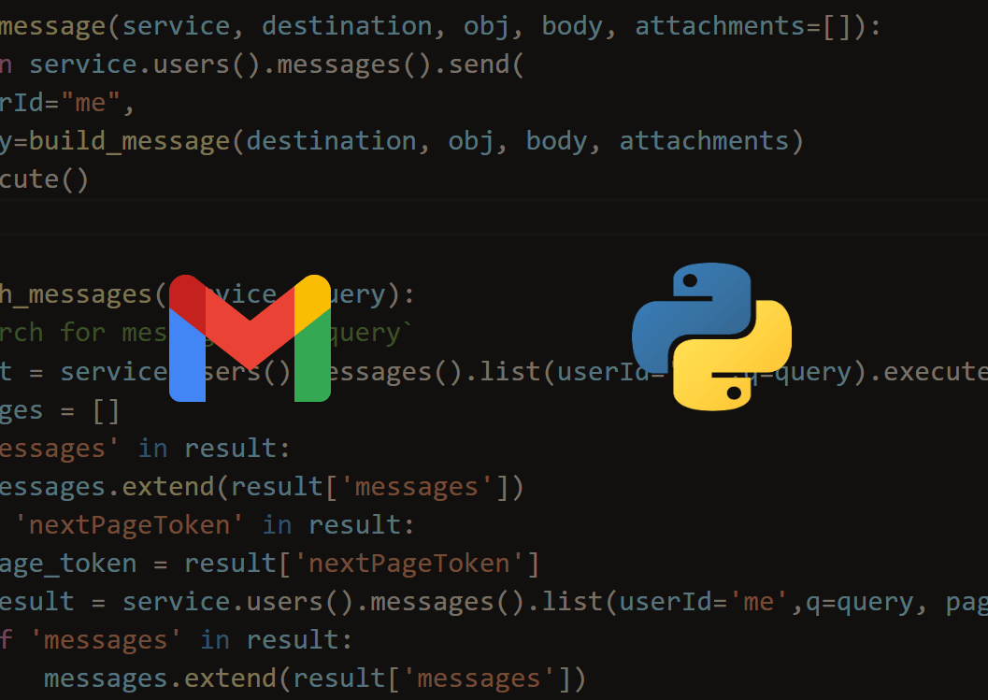
Demo
To assist in today’s Demo, we will be presenting it using GMAIL API. In This demo, the User is given the ability to load any # of emails that they wish. Our 2nd Demo will be able to provide a # of unread messages they may have and display the very first one. We also implemented Speech Recognition for our last Demo. Jarvis will be listening to the user and displaying the message as a text.

Slide 11
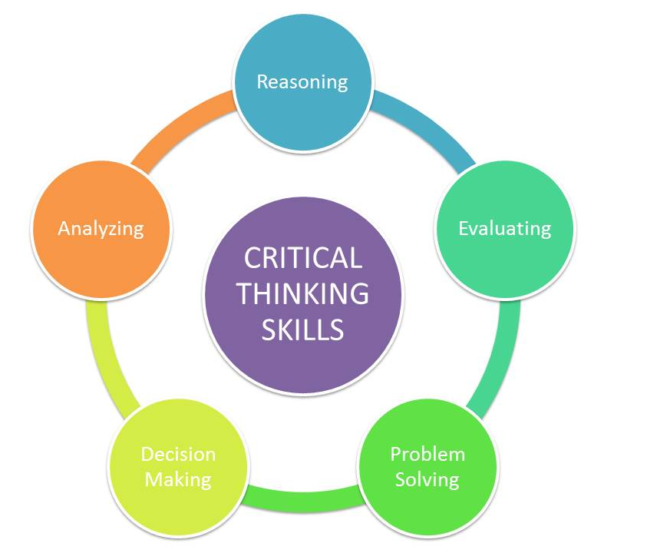

Conclusion
Although we had some errors with the GMAIL API token and unable to successfully create a filter demo. We were able to work with the internal information calculating the true # of emails that were considered Spam. We had the pleasure of improving our critical thinking skills. There has been various trial and errors in the production of Jarvis. Jarvis was able to provide the user the ability to load any number of emails that they wished to display. We also became very knowledgeable, on how the Innovation Center helps students improve their skills sets. By providing courses that have been partnered with great companies!
Cites used:
Gu, Mandy. “Ling-Spam Dataset.” Kaggle, 15 Nov. 2019, https://www.kaggle.com/mandygu/lingspam-dataset.
Email Spam Detection Using Python & Machine Learning - YouTube. https://www.youtube.com/watch?v=cNLPt02RwF0.
Moataz, Khalid. “What Is the Confusion Matrix and How to Use It.” Medium, Analytics Vidhya, 4 Sept. 2020, https://medium.com/analytics-vidhya/what-is-the-confusion-matrix-and-how-to-use-it-6dd63fab33ed
Email Spam Detection Using Python & Machine Learning - YouTube. https://www.youtube.com/watch?v=cNLPt02RwF0.
INNOVATION CENTER
https://www.crummy.com/software/BeautifulSoup/bs4/doc/

Slide 12


